Slide 1
CDI Collaborative
Susan Irving, RN, CIC, MPH
Lila Bareford, RN, CIC ,BSN
Beverly Hospital , Addison Gilbert Hospital
Kathy Evans, LPN
Seacoast
Andy Myer RN
Ledgewood
Karen Tysver RN
Essex Park

Slide 2
Objectives
Describe the teams experience with small test of change to improve communication between the Long Term Care Facility and the Hospital.
Identify Strategies to reduce incidence of Clostridium Difficile during a cluster of infections
Describe how sharing of Clostridium Difficile cluster of infections across the continuum of care prepares the long term care facilities to decrease the spread of Clostridium Difficile in their homes .
Describe a process to measure cleanliness in the environment.

Slide 3
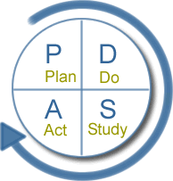

Slide 4
AIM: The collaborative team was seeking to improve communication at discharge to include history of Clostridium Difficile and other MDRO’S
PLAN: To identify the type of precautions that a patient was on during hospitalization. If there was a history of multidrug resistant organisms, or Clostridium Difficle.
DO: A trial of nurse to nurse report from hospital to Nursing Home implemented.
STUDY: The trial went well between one hospital and one nursing home . Another trial at a second hospital and nursing home calls were not consistent.
ACT: The trial was discontinued on a number of nursing units and concentrated onone to work on areas for improvement in the process

Slide 8
HAI Clustering Interventions
Team formed that included ICP,s Nursing representatives, Environmental Services and Infectious Disease Physician ,Laboratory
Only liquid stool is accepted for C. Difficile testing by the lab. All formed stool is rejected C. Difficile testing has been moved from 2:00 p.m. daily to between 9:30 and 10:00 am daily. Results are available by 12:00 noon . We use PCR testing for C-Diff.
Cleaning of equipment between patient use with bleach for C. Difficile patients
Reinforced the use of gloves and gowns utilization observed on daily rounds by ICP
Share information on cluster and interventions with C. Difficile infection (CDI) Collaborative Nursing Homes
.

Slide 9
HAI Clustering Intervention
Dispatch, one step cleaning and disinfectant in place on all units in two hospitals
Dispatch disinfectant used for all bathrooms throughout hospital
Dietary service education on gown and glove use with “hands on” demonstration
Admitting department educated on placing patients on admission in private room on CONTACT PLUS with symptoms suspected or confirmed C. difficile illness
HALO defogger business plan to be presented to Projects Review Committee (a hydrogen peroxide mist that kills MDRO and c. difficile on patient equipment such as curtains, wheel chairs and IV poles without harming equipment
Hospital wide c. difficile education completed. A Team approach to environmental cleaning has widely contributed to the success of the decreased c. difficile cases.

Slide 10
One c.difficile case in May Two c. difficile cases in April compared to 4 cases in March The NHC rate per 1000 patient days February 1.65, March 0.71, April 0.30, May 0.16
Began ATP, a measurement for cleaning in use in March
The new method for assessing cleaning by the Clostridium Difficle team was an ATP (adenosine triphosphate) monitoring system to improve the cleanliness of our environment. Adenosine triphosphate is a chemical found in all living organisms and biological residues. ATP provides a mean of measuring if there is organic residue left in our environment
High Touch points on our medical surgical floors include

Slide 11
High Touch points on our medical surgical floors include:
Over the bed table top
Under the over bed table
Bedrails
Bedside Table
TV Control
Telephone keypad
Toilet seat
Sink handle hot water
Light switch in bathroom and room
Equipment that has been tested
IV pumps , computers on wheels, Vital sign machines, Commodes, Pulse Oximeter

Slide 12
Thresholds were set at 500 for pass, 500-1000 caution and over 1000 fail. After 3 months of data collection these will be reevaluated. Our goal is to lower the fail Threshold by 25% by October to 750.
High touch points will be evaluated with new points added.
Weekly reports are generated and sent to Environmental Services and Infection Prevention & Control managers. Reports of results are shared at the Infection Prevention & Control Committee meeting.
Used as a teaching tool throughout the hospital to demonstrate the cleanliness of the environment and equipment that is shared between patients.

Slide 13
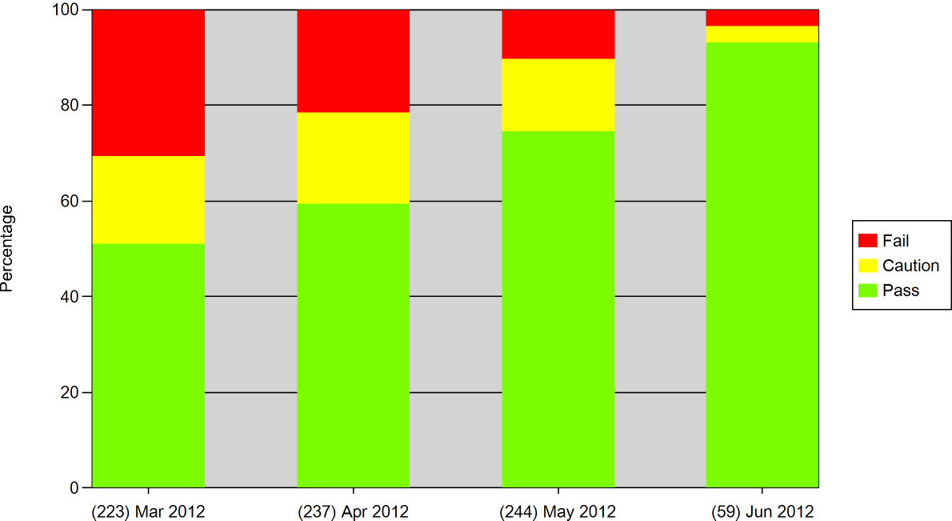
Stacked Bar Chart Sample Plan Type: Audit March 2012-June 2012 Swab Type: ATP-Surface
 | Pass Threshold = 500 Fail Threshold = 1000

Slide 14
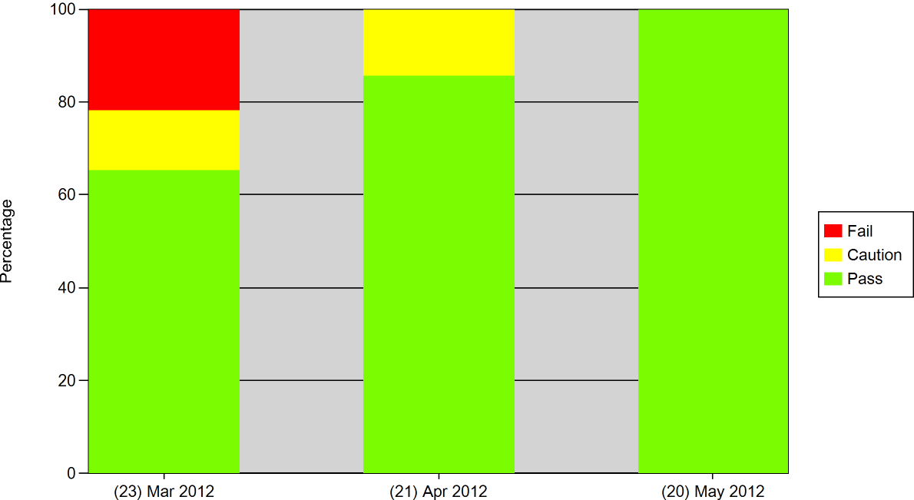
Beverly Hospital Stacked Bar Chart MARCH 2012-MAY 2012 Swab Type: ATP-Surface
 | Pass Threshold = 500 Fail Threshold = 1000

Slide 15
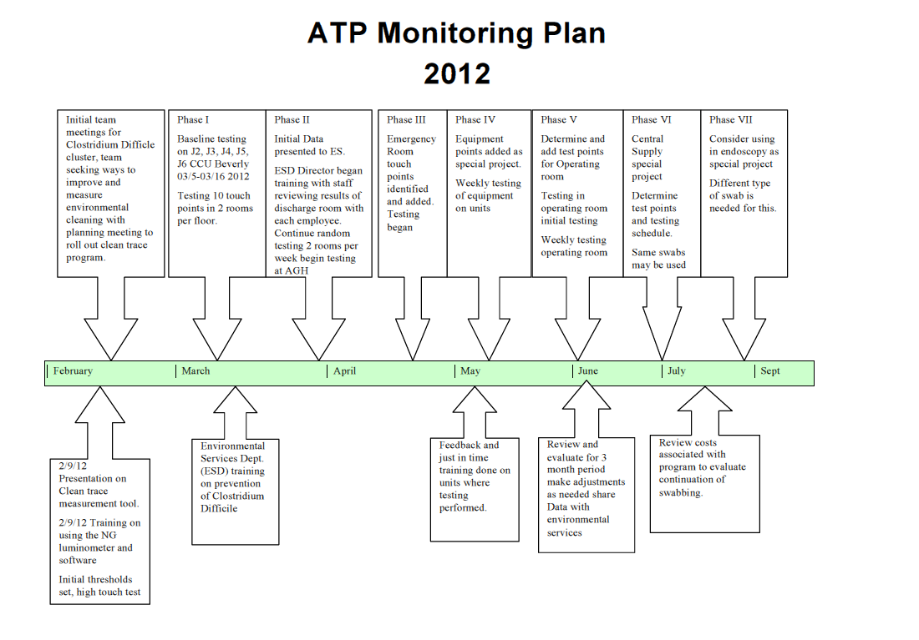

Slide 16
References
Options for Evaluating Hospital Cleaning: http://www.cdc.gov/HAI/toolkits/Appendices-Evaluating-Environ-Cleaning.html#a
Vital Signs: Preventing Clostridium Difficile
http://www.cdc.gov/mmwr/preview/mmwrhtml/mm6109a3.htm?s_cid=mm6109a3_w
CDC Healthcare-associated infections ( HAI)
http://www.cdc.gov/HAI/organisms/cdiff/Cdiff_faqs_HCP.html

